Slide 1


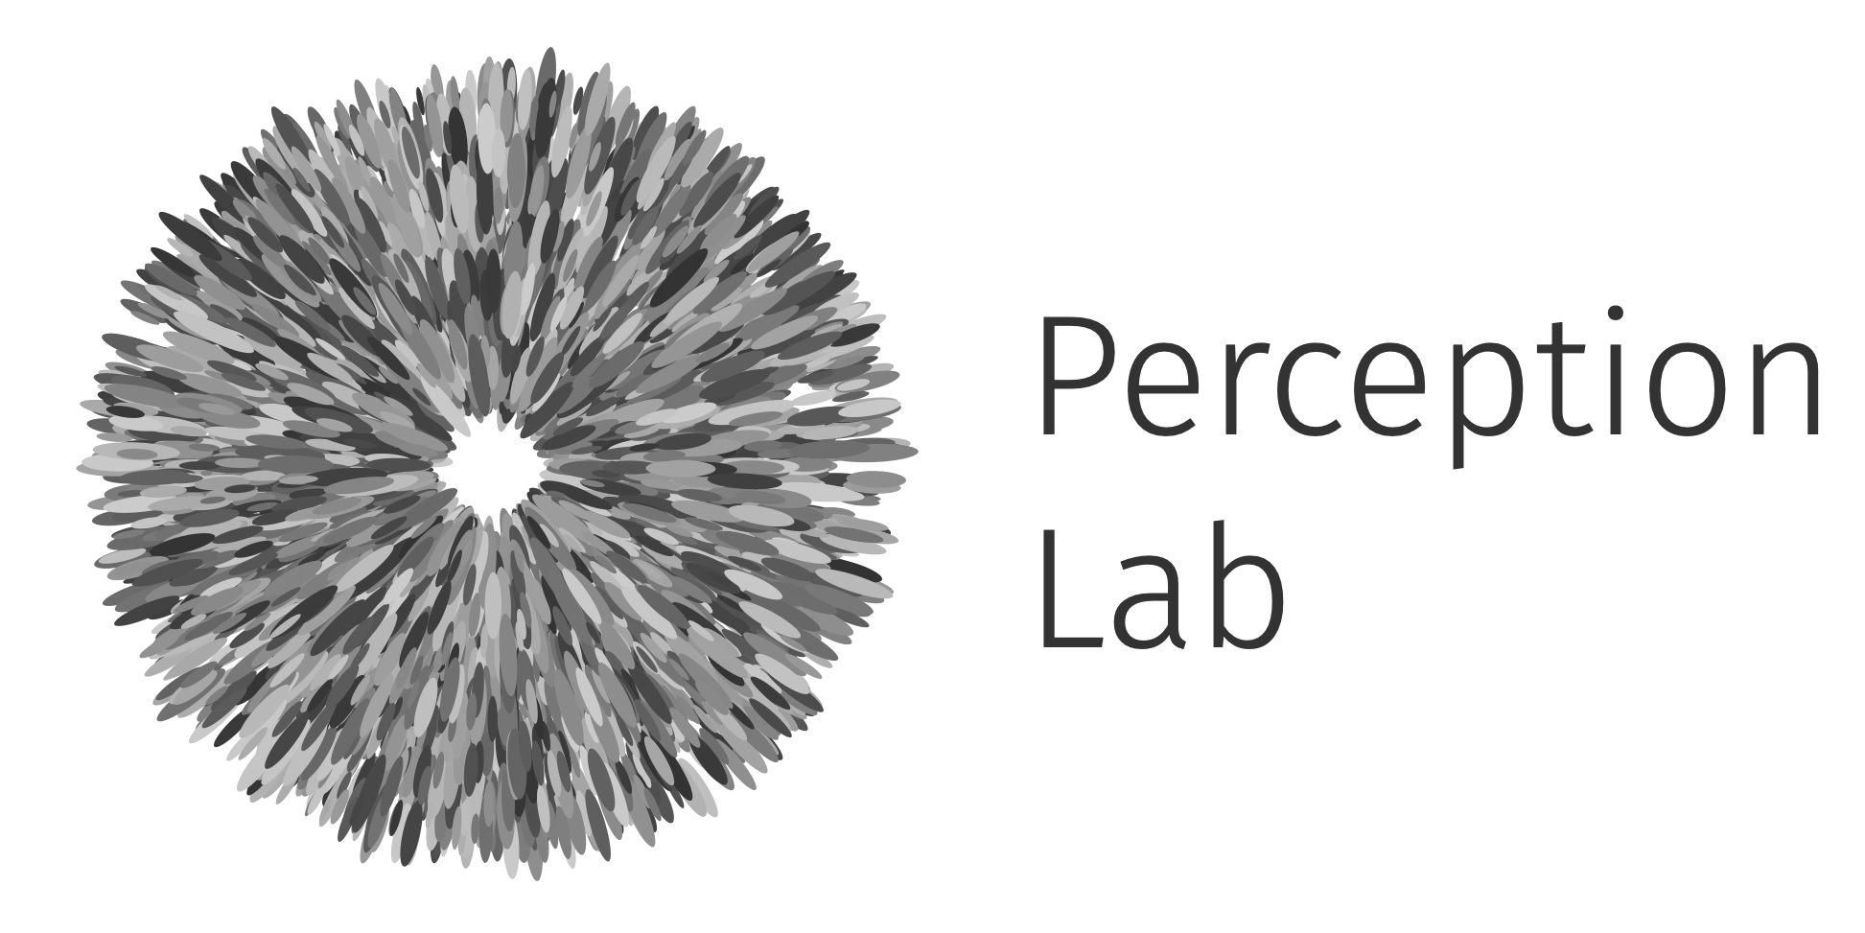





Applications of Physically Based Differentiable Rendering in Vision Science
Benjamin Beilharz, Joshua Martin & Thomas S. A. Wallis
Perception Lab – Technical University of Darmstadt

Slide 2
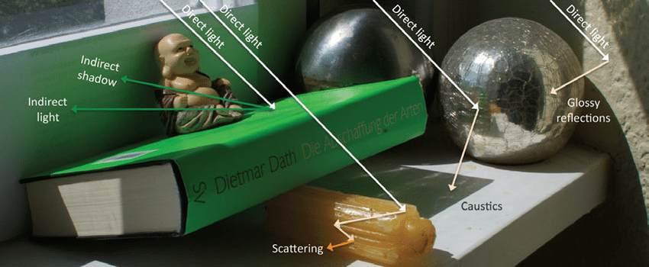
Image courtesy of Tobias Ritschel

Slide 3
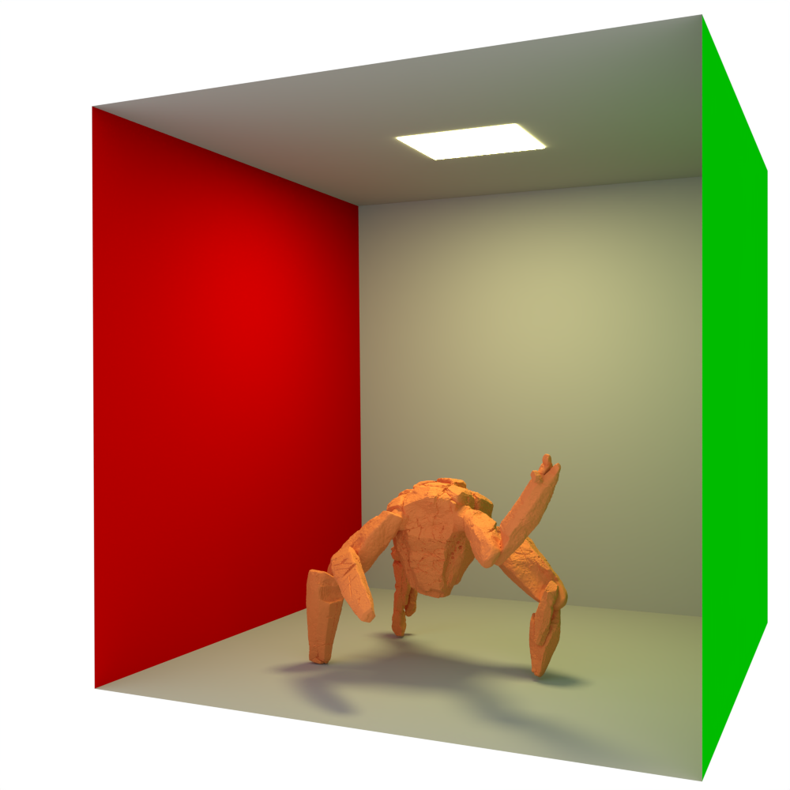

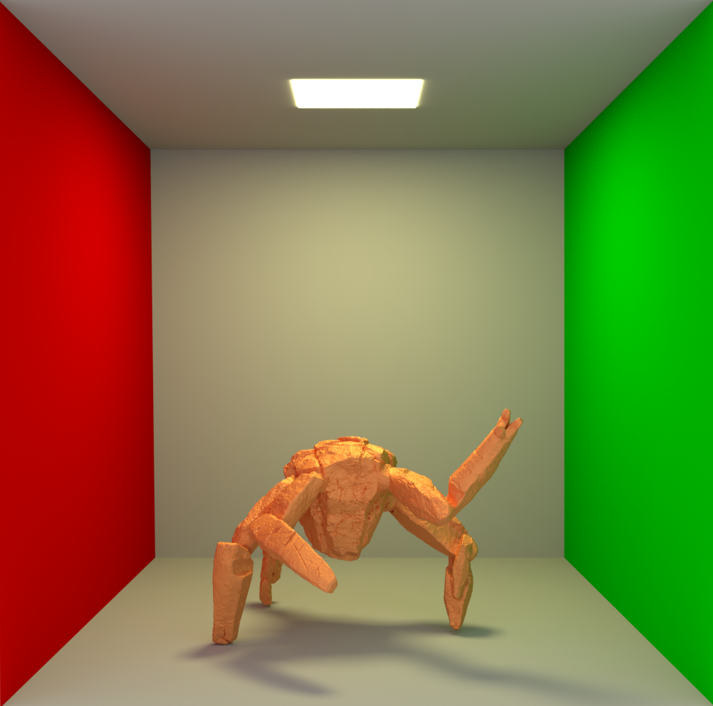
Physically Based Rendering
Physically based
Interpretable

Slide 4
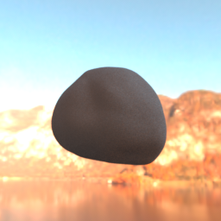
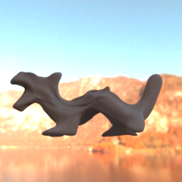

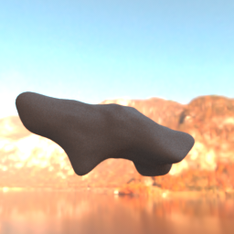
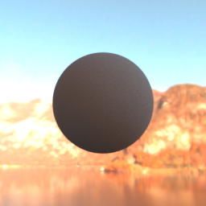
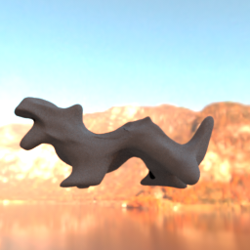
Physically Based Differentiable Rendering
Physically based
Interpretable
Differentiable

Slide 5
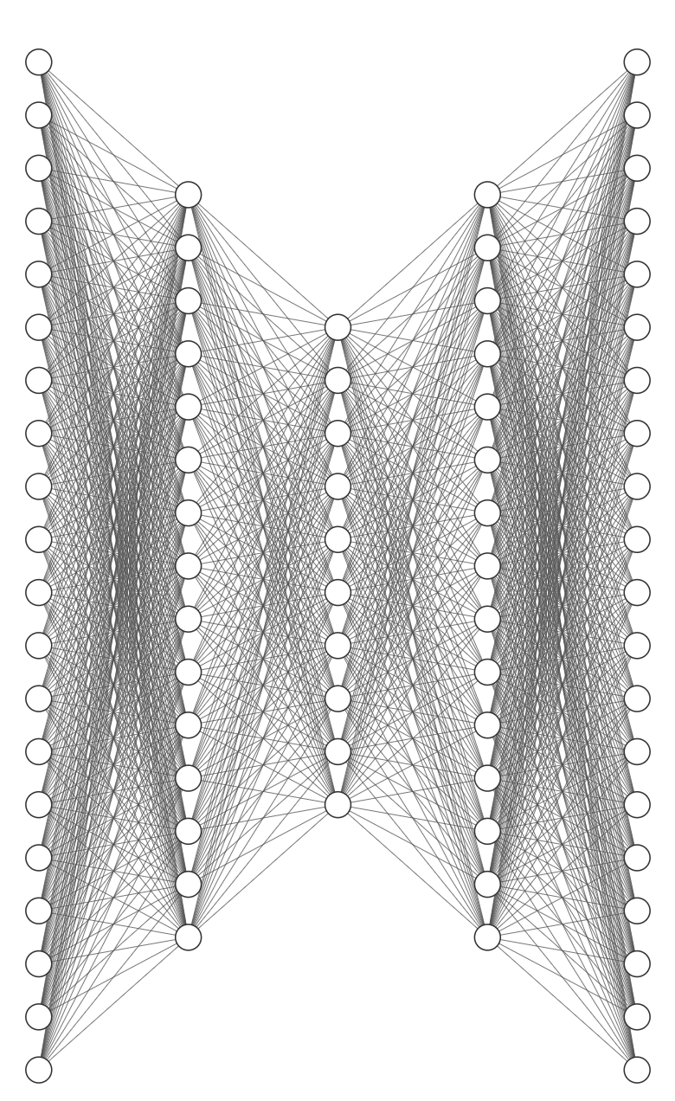
Differentiable Rendering (DR) grounds models in physical parameters.
Encoder
Decoder
Encoder
Decoder
DR as the encoder can ground the decoder in physical parameters. Full control over stimulus generation.
End-to-end differentiable.
The Encoder maps modality to physical parameters. DR as the decoder grounds the modality in verifiable physical parameters. End-to-end differentiable.

Slide 6
MRD: Using Physically Based Differentiable Rendering to Probe Vision Models for 3D Scene Understanding
(accepted at JoV; in press)

Slide 7
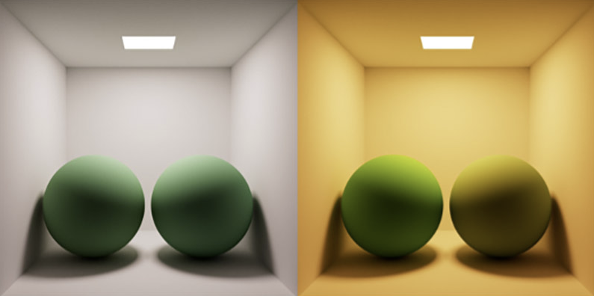
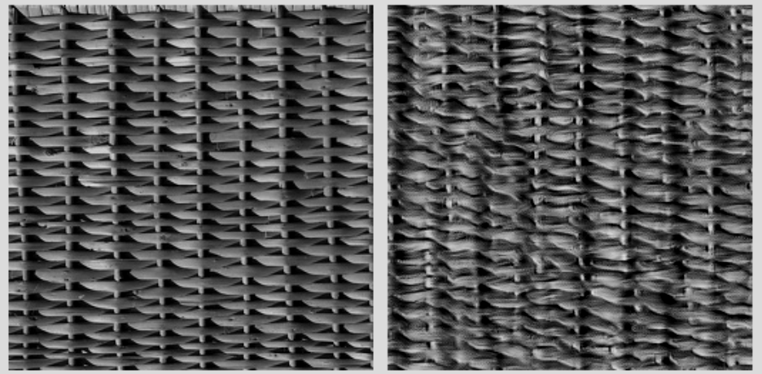
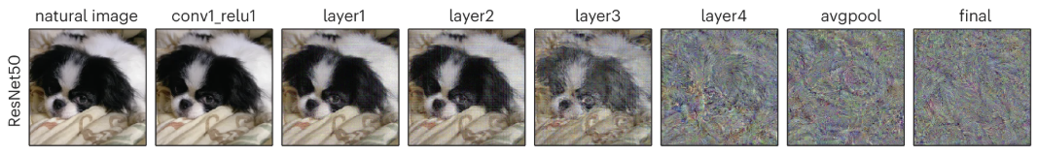
Metamers
Colour metamer
Image statistics metamer (Portilla & Simoncelli 2000, Freeman & Simoncelli 2011)
Neural Network metamer
(Feather et al. 2023)

Slide 8
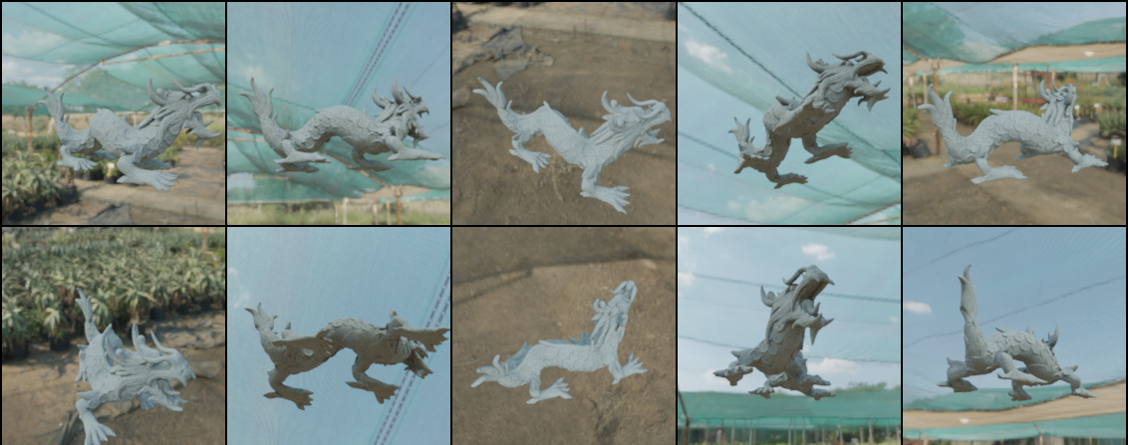
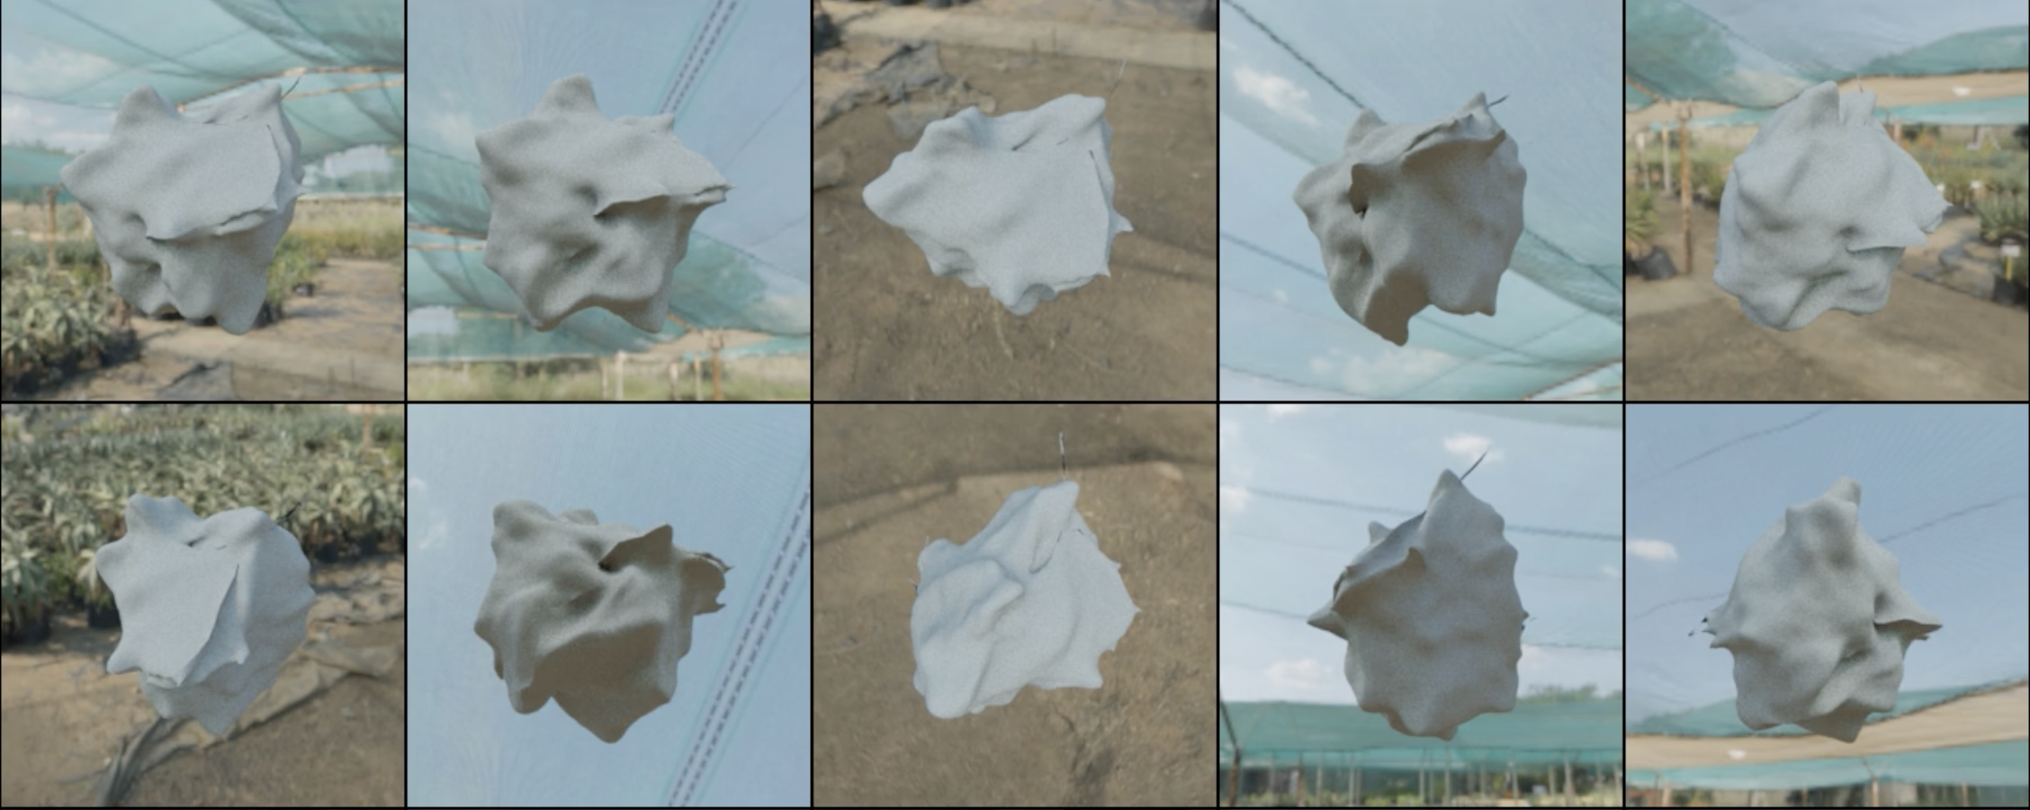
Metamers
Colour metamer
Appear the same to the neural network
Image statistics metamer (Portilla & Simoncelli 2000, Freeman & Simoncelli 2011)
Neural Network metamer
(Feather et al. 2023)

Slide 9

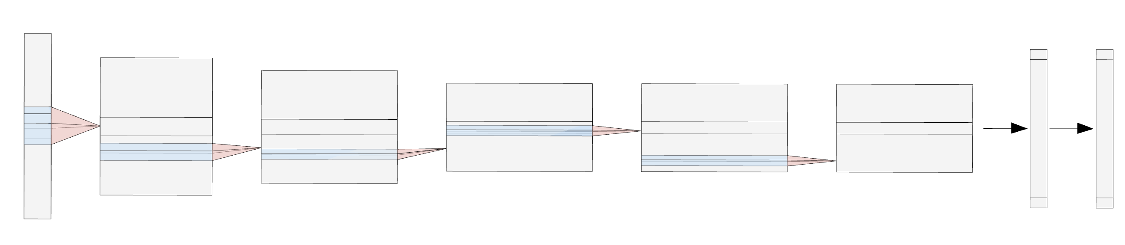
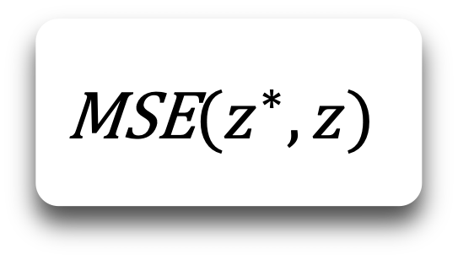


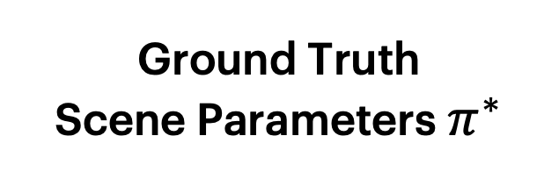

Reconstructing parameters from latent spaces
Geometry Example
Ground Truth
Scene Parameters $π^{∗}$
Scene Parameters
$$π$$
Render $π^{∗}$
Embed in neural network’s representation $z^{∗}$
Geometry
Geometry
Material
$$\text{MSE}(z^{∗},z)$$
Material
(Fixed)
Render $π$
Embed in neural network’s representation $z$
Light
Light
(Fixed)
Camera
Camera
(Fixed)
Update scene parameters: $\frac{∂\text{MSE}}{∂π_{\text{vertices}}}$

Slide 10
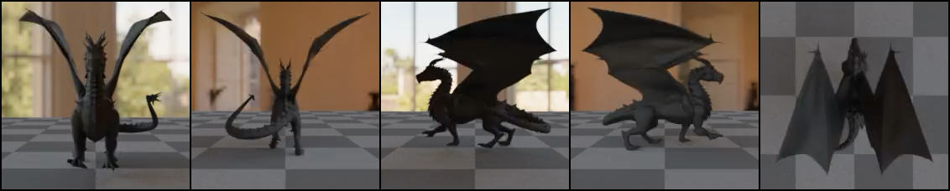
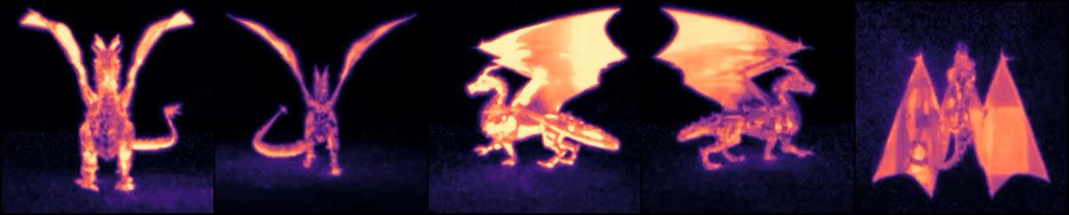
Results
Reconstruction
Error Map
CLIP
Translucent

Slide 11
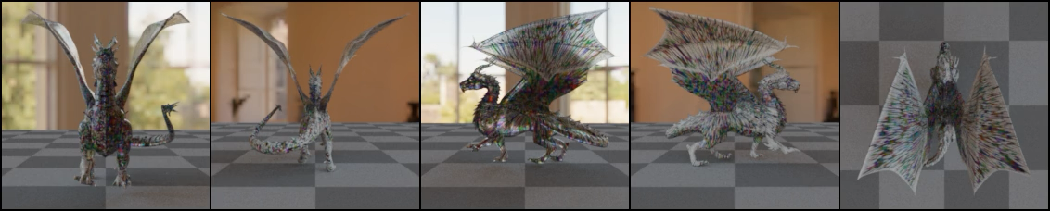
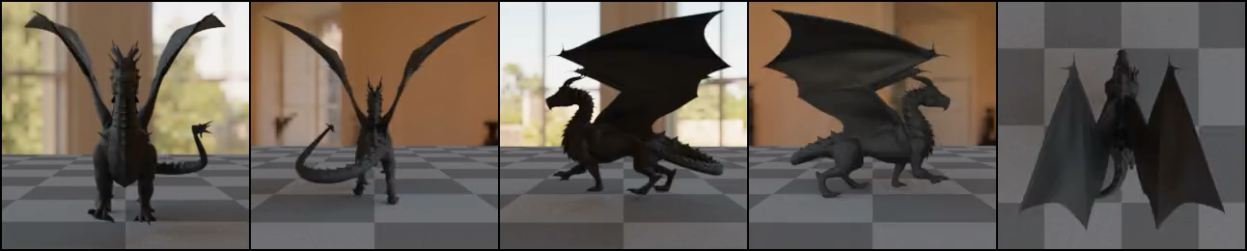
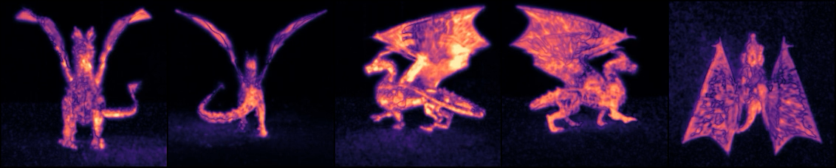

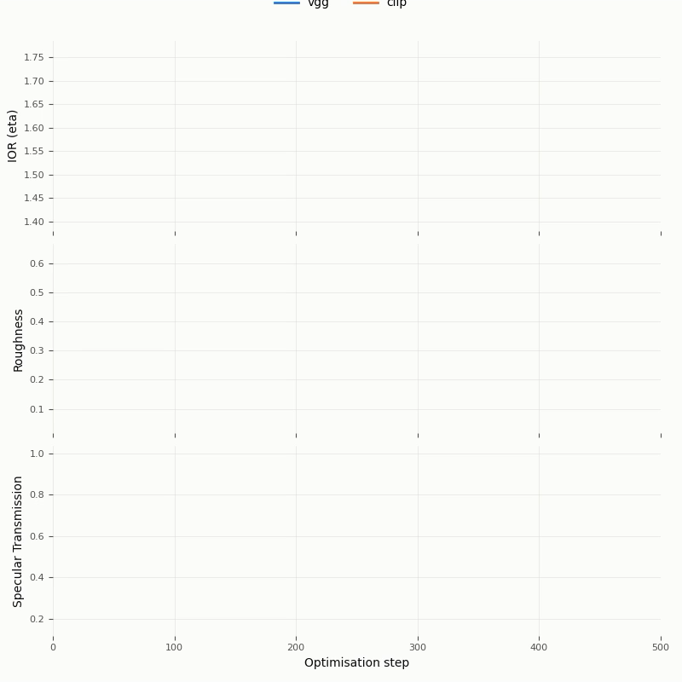
Results
CLIP
Translucent
VGG
Translucent

Slide 12
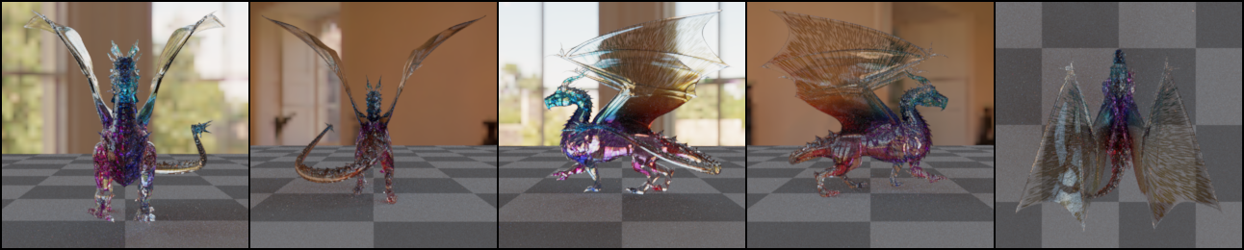


Results
Same model activations
(model metamer)
Same model activations
(model metamer)
CLIP
Translucent
VGG
Translucent

Slide 13
Controversial Scenes
(work in progress)

Slide 14
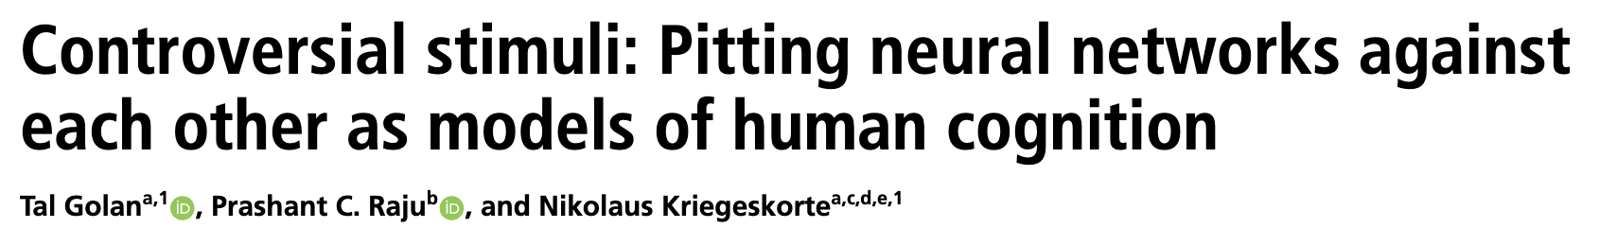
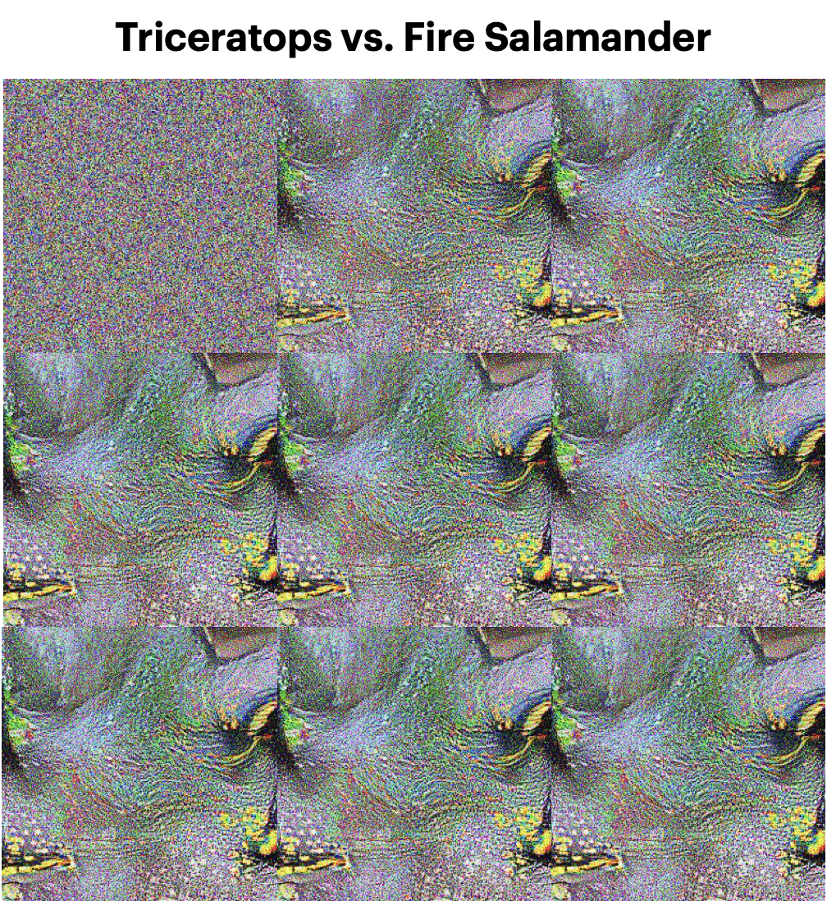
Triceratops vs. Fire Salamander

Slide 15
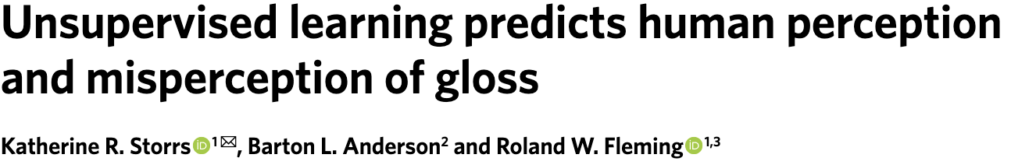
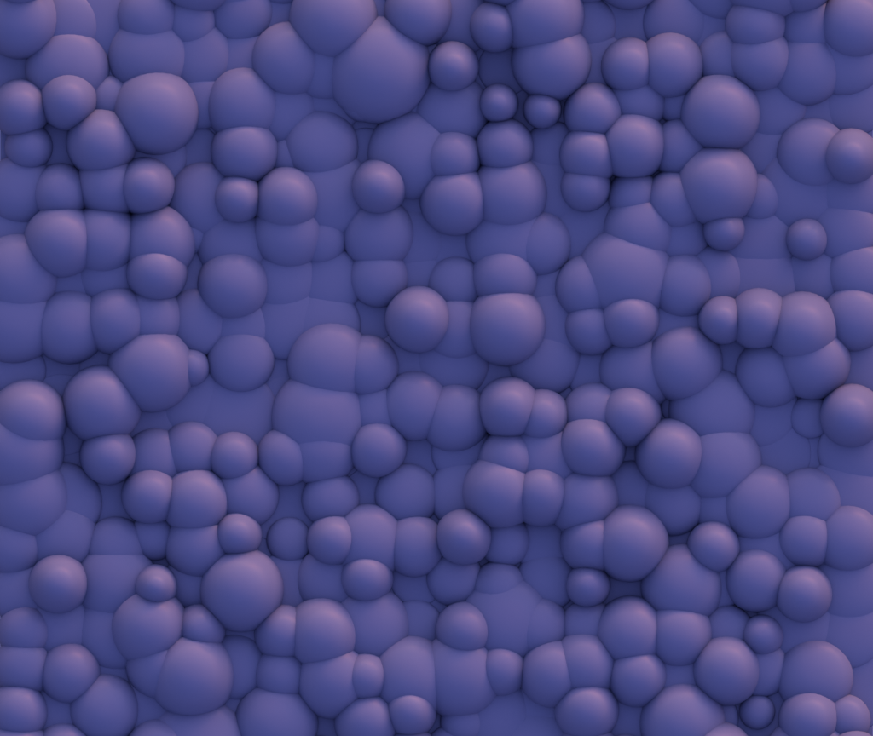
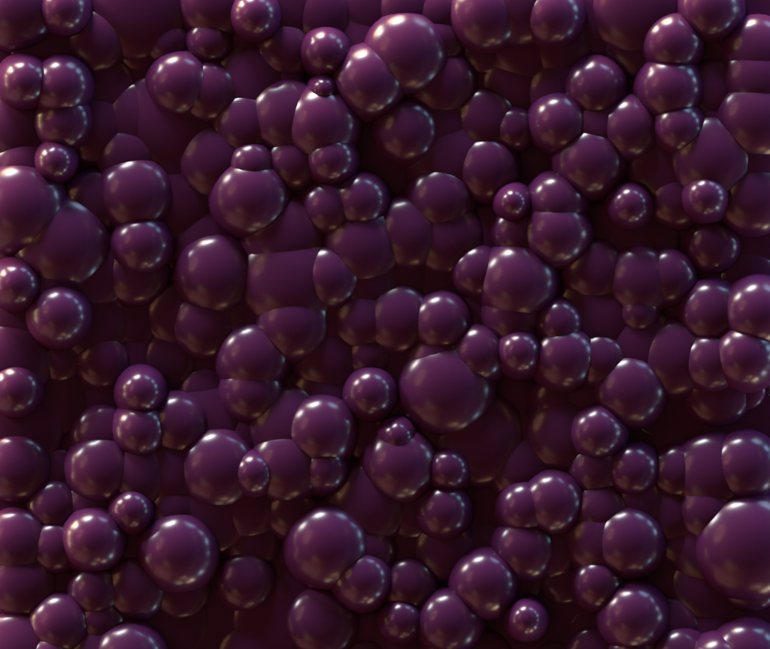

Slide 16

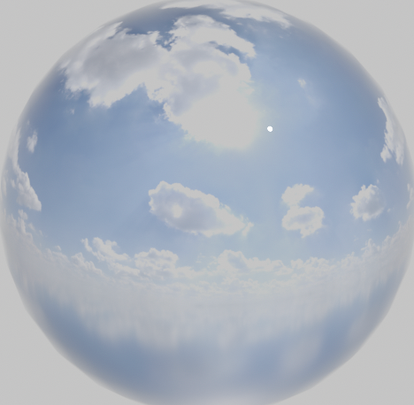
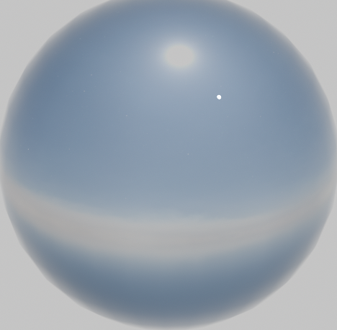

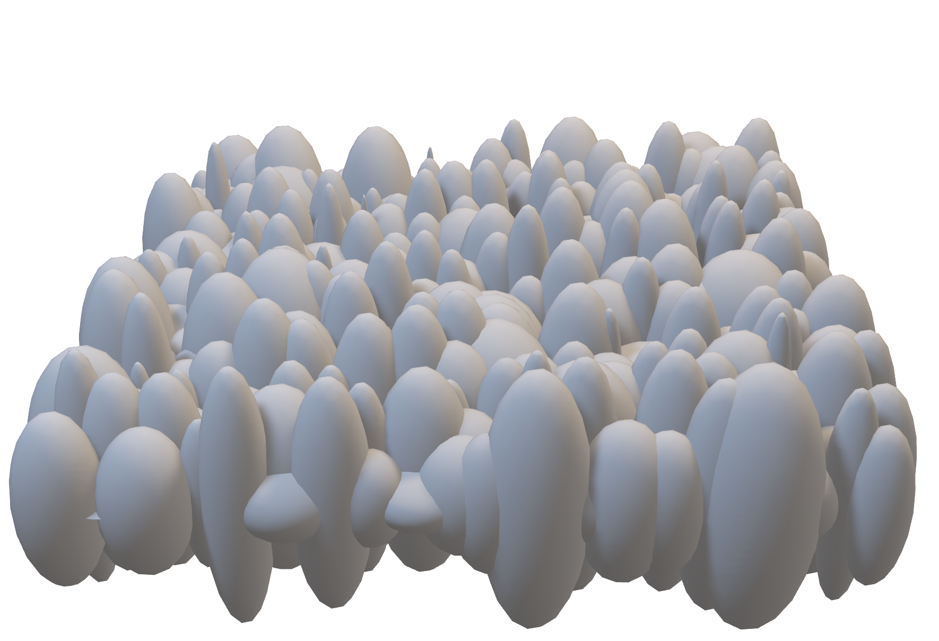
Glossiness has multiple factors
Surface Relief
Material & Viewing Direction
Lighting

Slide 17
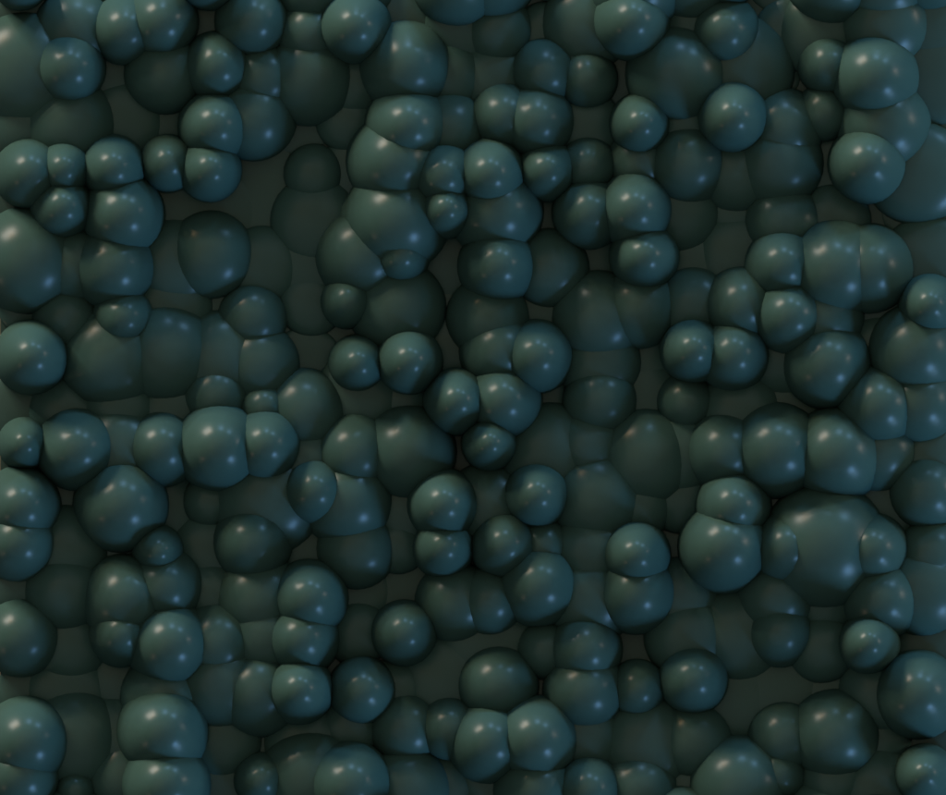
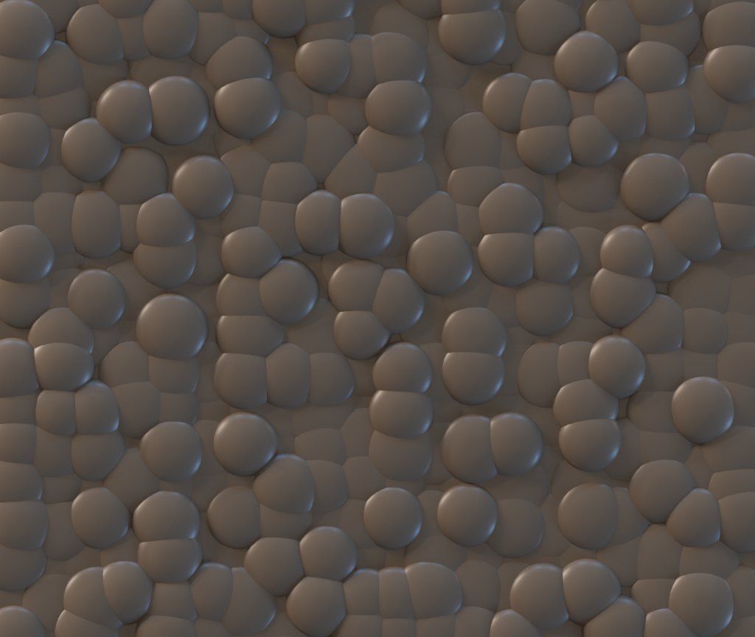
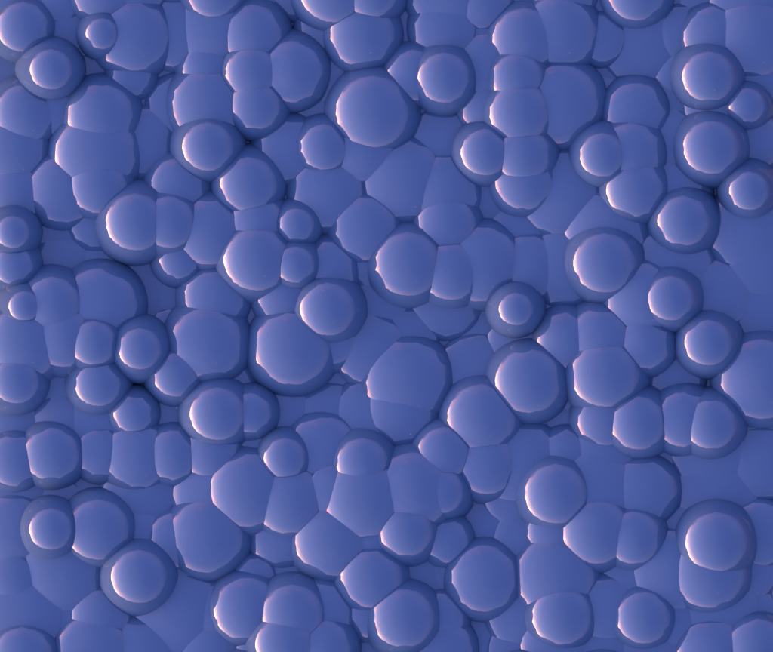
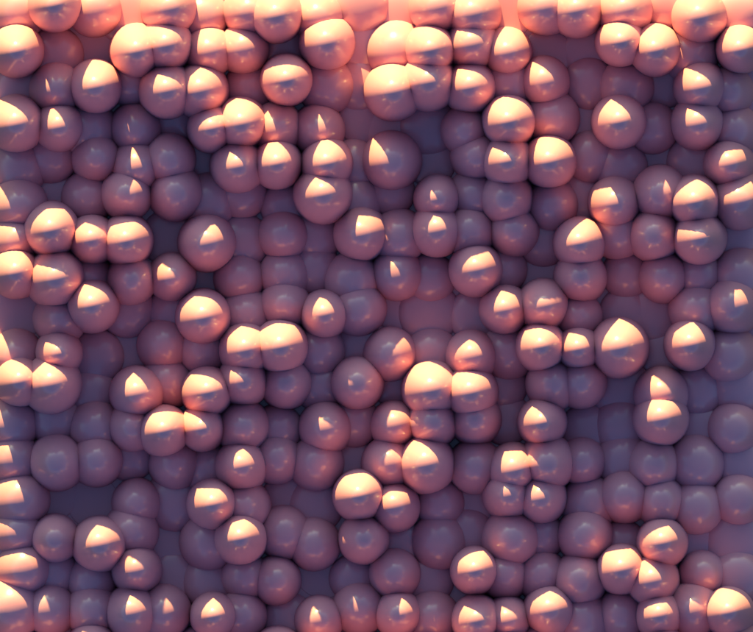
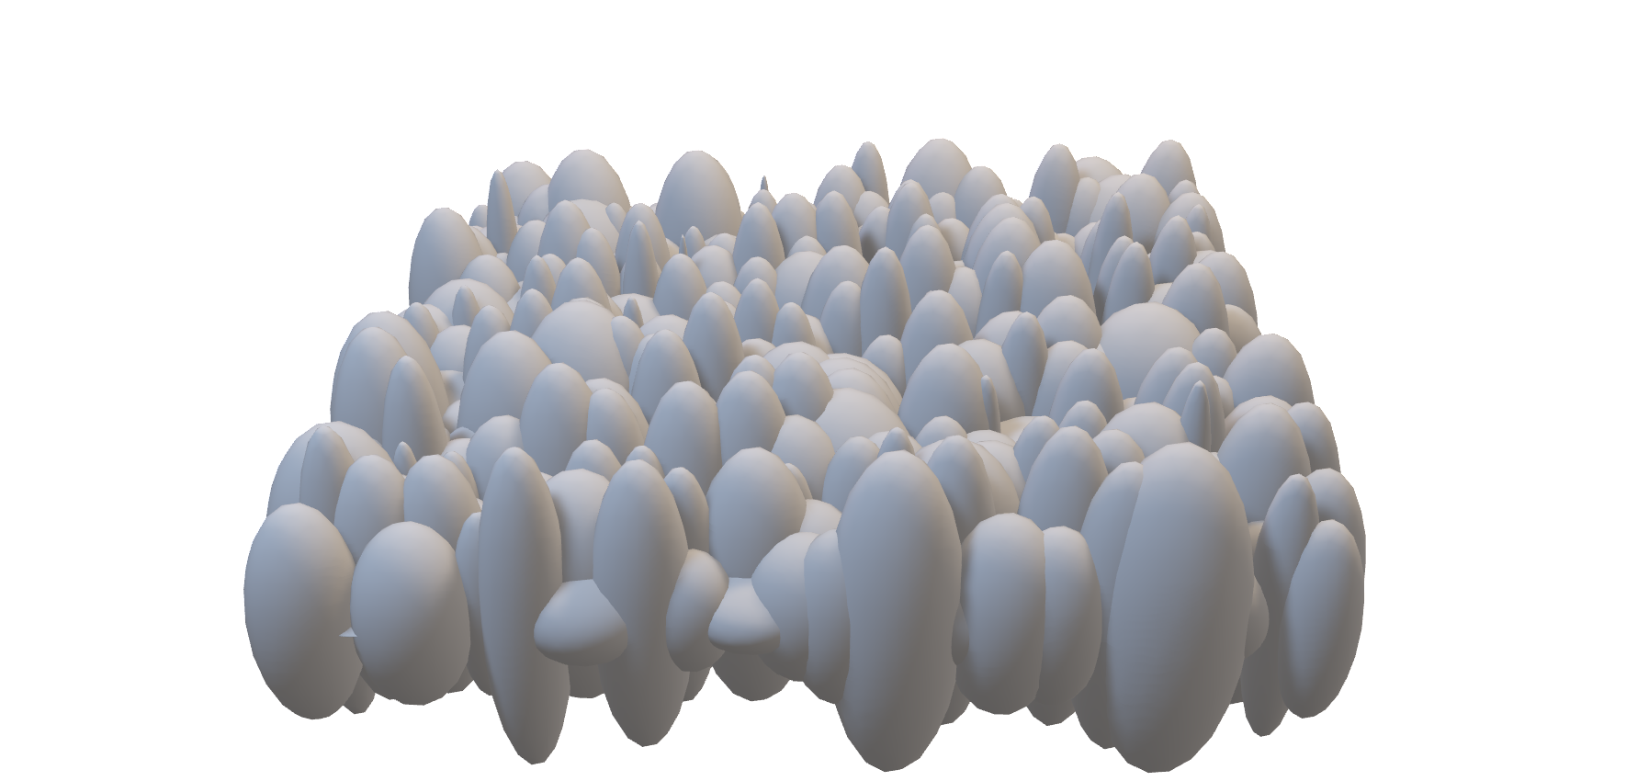
Dataset Generation
Surface Relief
Material & Viewing Direction
Lighting

Slide 18
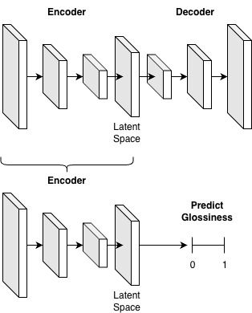
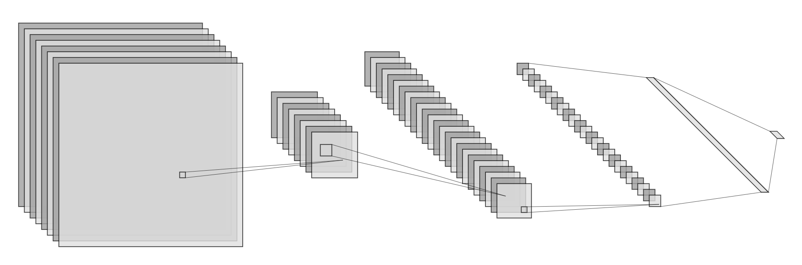
Learning Neural Networks on Glossiness
Unsupervised:
(PixelVAE)
Fine-tuned unsupervised network on glossiness:
(PixelVAE + Regression)
Supervised:
(ConvNext)

Slide 19
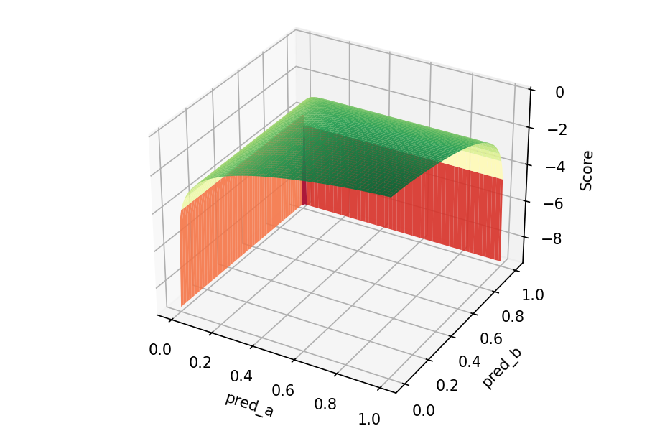
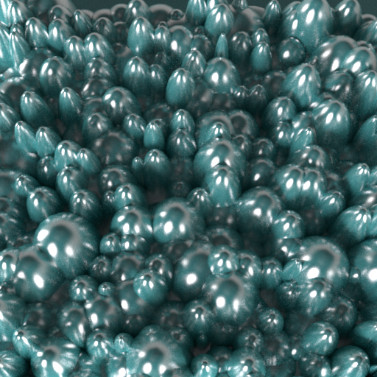

Controversial Scene Optimisation
Scene Parameters $π$
Model A
↑
Geometry
(fixed)
Render
Material
Model B
↓
Light
(fixed)
Camera
(fixed)
Compute gradient and update scene parameters.
Compute unidirectional disagreement score
(Model A requires to predict high glossiness and Model B low glossiness)

Slide 20
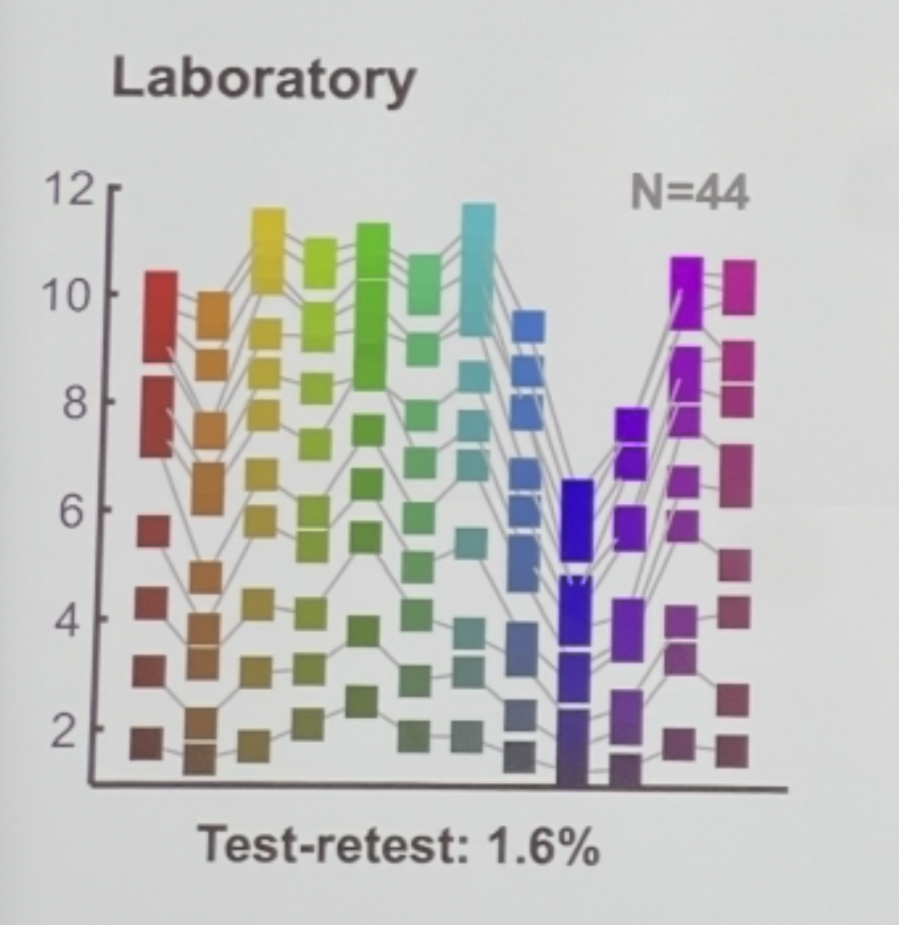
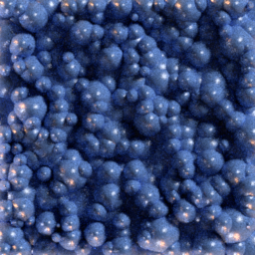
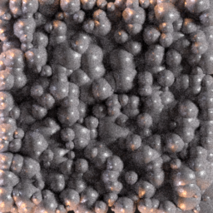
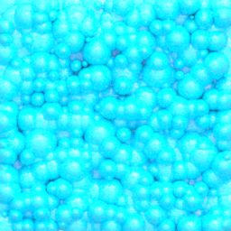
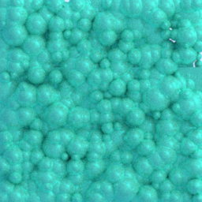
Preliminary Results: Material Parameters
Fine-tuned model predicts high gloss, supervised model predicts low gloss.
0.51
0.67
0.70
0.76
Psychophysics will follow.
Higher score = higher model disagreement.

Slide 21
Verdict time!

Slide 22
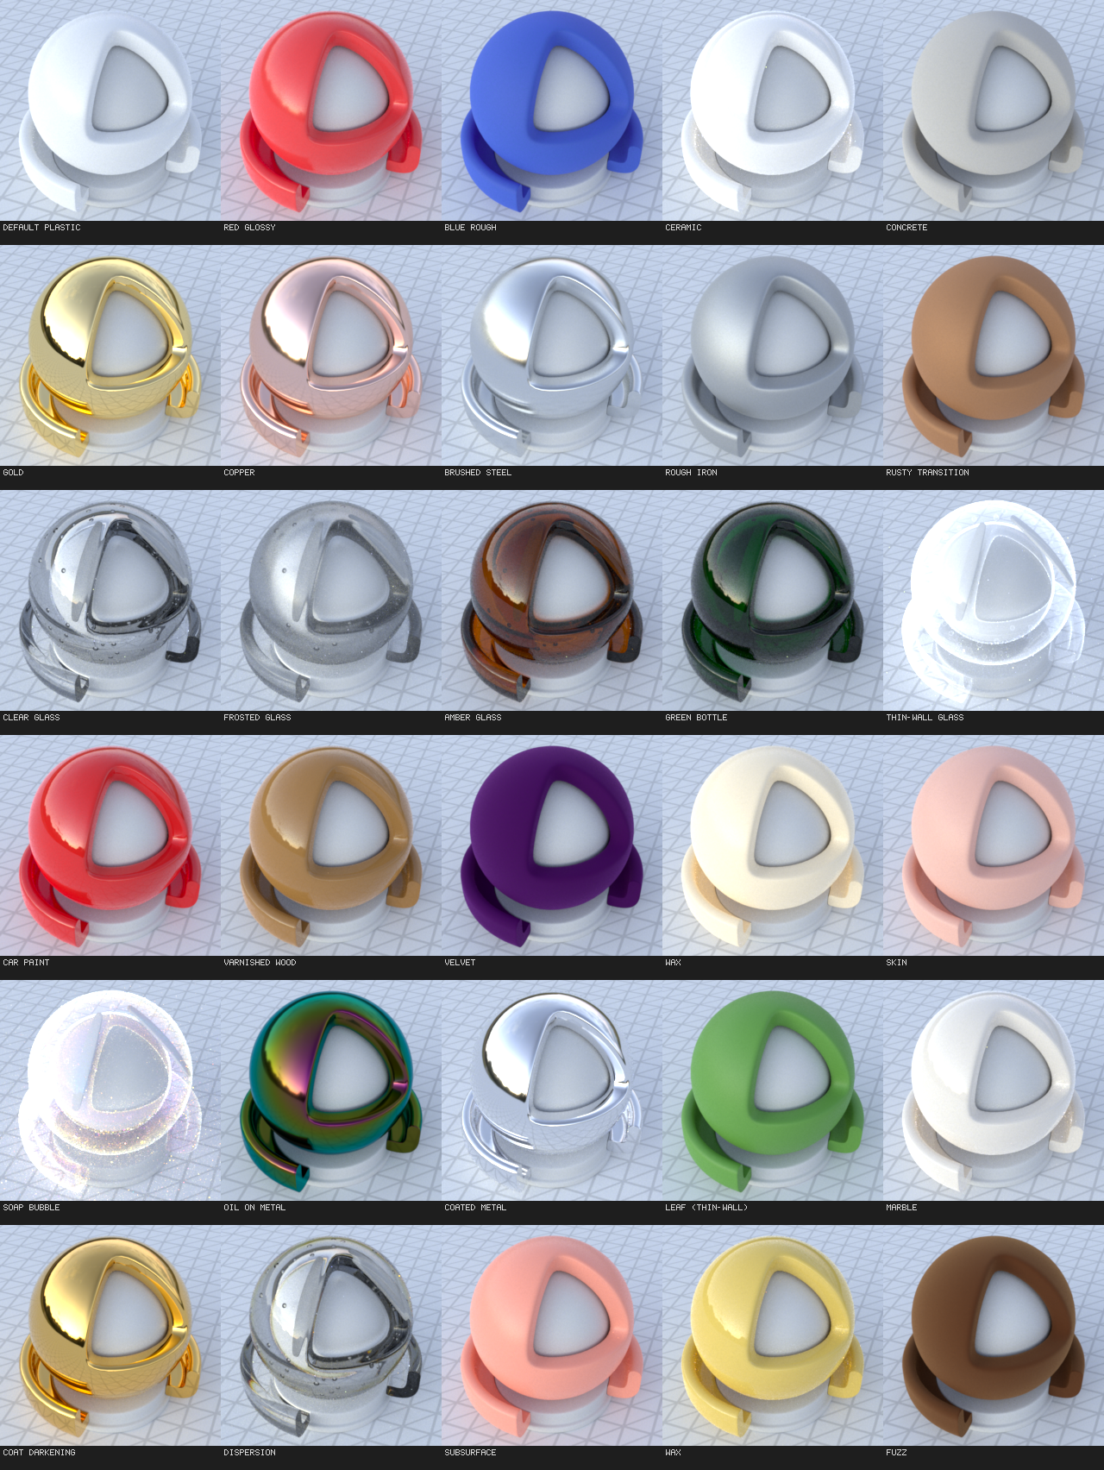
You can always extend existing material models.

Slide 23

Differentiable rendering
grounds models of vision and stimuli
in an interpretable and optimisable physical space.
Vision Science
Differentiable
Rendering

Slide 24



Thanks!
@engramm.ing
benjamin.beilharz@tu-darmstadt.de
MRD (Repo with paper link)
A primer on physically based differentiable rendering in vision science.

